Slide 1
Wanderslog -a TRAVEL BLOG
-BY VIKRAM,SAMRIDDHI,RIDDHI,SIMRAN

Slide 2
PROJECT OVERVIEW
"Wanderslog is a travel logging website where users can document their journeys, upload pictures, and share experiences."
"The main objective of the project is to create a platform where travelers can track and revisit their travel history."

Slide 3

Context & Motivation
The idea came from the need for a centralized, personal space for travel memories, different from social media."
"It’s meant to serve as a digital journal that also allows for insights like trip frequency, locations visited, and more."

Slide 4
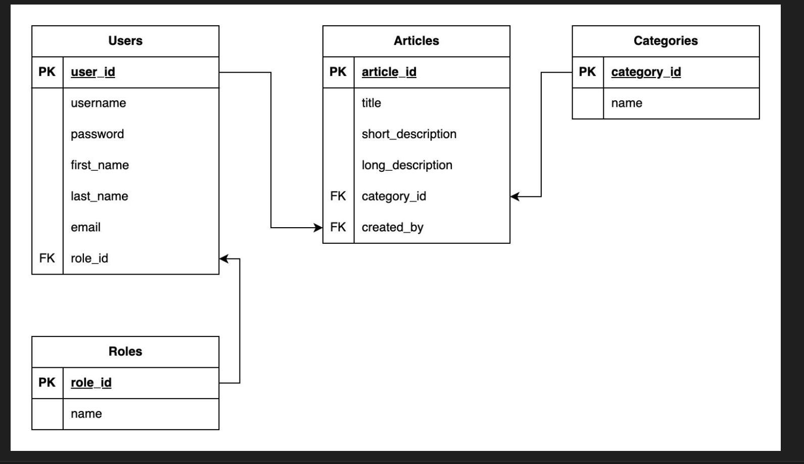
Architecture Diagram

Slide 5

Key Features
The main features of Wanderslog include:"
User authentication (login/register)
Creating, viewing, editing travel logs
Uploading photos
Interactive map to view logged locations
Travel statistics dashboard (e.g., number of trips, countries visited)

Slide 6
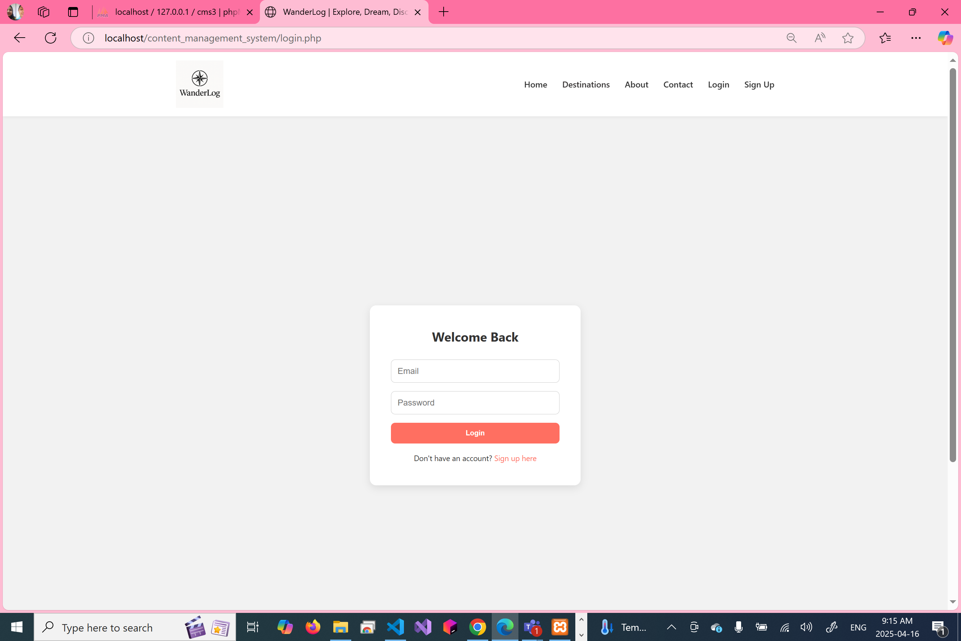
Login Section

Slide 7
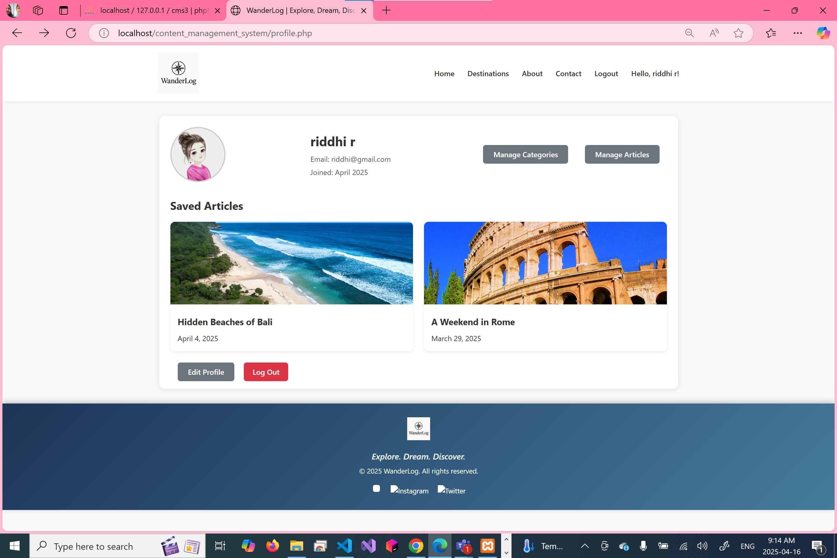
After Login the person can see the profile

Slide 8
Results Obtained
The platform is functional and allows users to maintain a consistent log of their travels."
“We have successfully tested the database connections, session management, and photo uploads."

Slide 9
Challenges & Solutions
"One challenge was handling image uploads and associating them correctly with user posts. I solved this by structuring the database with foreign keys linking posts and image tables."
"Another issue was ensuring secure login functionality – I addressed this with password hashing and session handling in PHP."

Slide 10
Summary
To summarize, Wanderslog is a personal travel logging platform that combines usability with essential travel features."
"It uses PHP for the backend logic and a MySQL database to store user and post information."

Slide 11
Future Improvements
"In the future, I’d like to implement:"
Social sharing options
Better mobile responsiveness
AI-based suggestions for destinations based on logged trips
Data export/import options for backup"

